Slide 1

Tredence: Bridging the Last Mile in AI
A comprehensive analysis of Tredence's position in the global data analytics industry

Slide 2
Company Overview
Founded 2013
3,500+
10+
Headquarters in San Jose, California
Founders: Shub Bhowmick, Sumit Mehra, Shashank Dubey
Global Employees
Delivery Centers
San Jose, Chicago, London, Toronto, Dubai, Bengaluru, Chennai, Gurgaon, Pune, Kolkata
Mission: Solving the "last-mile problem" in AI—bridging the gap between insight creation and value realization

Slide 3

Impressive Growth Trajectory
Revenue Growth
Series B Funding
$794.7M annual revenue with 40-50% year-over-year growth targets
$175M from Advent International in 2022 at $500M valuation
Expansion Plans
16% employee growth targeting 1,700 new hires in 2025 to reach 6,000 total employees

Slide 4

Industry Leader Recognition
Forrester Wave Leader
Everest Group Leader
ISG Provider Lens Leader
Customer Analytics Services Q2 2025: Highest possible scores of 5/5 in 15 criteria. Praised as "best in class for end-to-end CXM transformation"
Data and AI Services Specialists – North America PEAK Matrix 2025: Leader and Star Performer among 32 providers
Data and AI Services Specialists 2024: Leader among 19 qualified providers out of 77 companies assessed

Slide 5
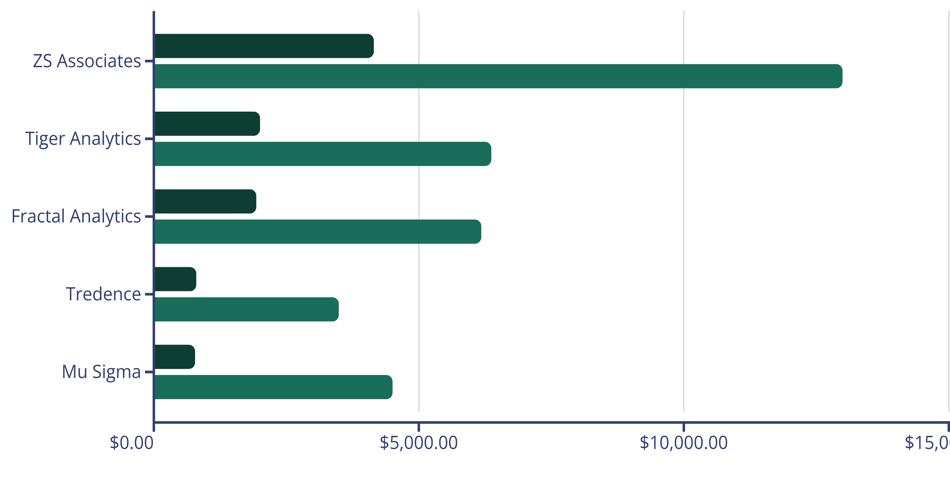
Competitive Landscape
Tredence competes among specialized analytics firms, operating below mega-consultancies but leading in the mid-market specialist segment
Revenue (Millions)
Employees

Slide 6
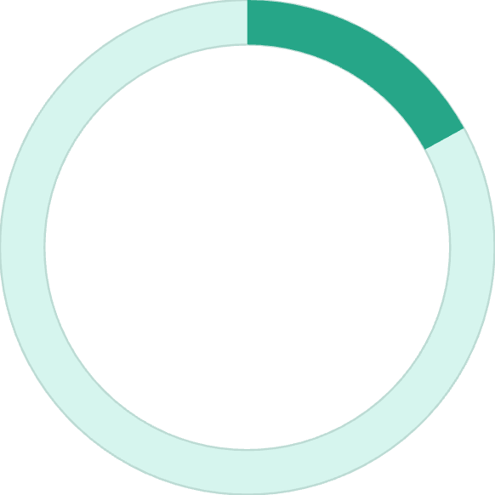

Tredence vs. Evalueserve
Strategic Positioning
Evalueserve is larger overall with 6,311 employees spanning broader services including market research and compliance.
17%
Tredence demonstrates superior efficiency with a focused, high-value analytics model rather than volume-based delivery.
Revenue Gap
Evalueserve leads with $928.5M-$945.2M vs. Tredence's $794.7M
2.2x
Efficiency Advantage
Tredence's revenue per employee is $314,600 vs. Evalueserve's $142,800

Slide 7
Core Service Portfolio
Advanced Analytics & Data Science
Data Engineering
Customer Experience Management
Cloud data architecture
Custom ML models
ETL/ELT pipelines
Customer data platforms
Predictive & prescriptive analytics
Data governance frameworks
Journey mapping & analytics
Statistical forecasting
Real-time streaming
Personalization models
Optimization algorithms
Omnichannel orchestration

Slide 8
Industry-Specific Solutions
Retail & CPG
Financial Services
Healthcare
Demand forecasting, inventory optimization, pricing strategies, trade promotion management
Risk analytics, compliance automation, fraud detection, customer lending analytics
Patient journey analytics, operational efficiency, predictive health analytics
Manufacturing
Telecom & Travel
Production optimization, predictive maintenance, supply chain intelligence
Churn prediction, customer lifetime value optimization

Slide 9





Pricing Strategy
Tredence employs flexible engagement models tailored to client needs, without public pricing disclosure
Project-Based
Time & Materials
Custom quotes based on scope, complexity, and timeline
For exploratory and evolving engagements
Outcomes-Based
Annual Licensing
Fees aligned with business results delivered
Platform solutions with monthly payment options
Key Pricing Factors: Engagement duration, data complexity, industry vertical, geographic delivery mix, and technology partnerships (GCP, Databricks, Snowflake)

Slide 10

The Tredence Advantage
What Sets Them Apart
Last-Mile Focus
Vertical Expertise
Operationalizing insights to drive tangible business impact, not just generating reports
Deep domain knowledge across key industries with specialized solutions
Proven Results
Industry-leading analyst recognition and superior revenue efficiency metrics

